Slide 1
Introduction to CUDA Programming
Textures
Andreas Moshovos
Winter 2009
Some material from:
Matthew Bolitho’s slides

Slide 2
Memory Hierarchy overview
Registers
  Very fast
Shared Memory
  Very Fast
Local Memory
  400-600 cycles
Global Memory
  400-600 cycles
Constant Memory
  400-600 cycles
Texture Memory
  400-600 cycles
  8K Cache

Slide 3
What is Texture Memory
A block of read-only memory shared by all multi-processors
  1D, 2D, or 3D array
  Texels: Up to 4-element vectors
      x, y, z, w
Reads from texture memory can be “samples” of multiple texels
Slow to access
  several hundred clock cycle latency
But it is cached:
  8KB per multi-processor
  Fast access if cache hit
Good if you have random accesses to a large read-only data structure

Slide 4
Overview: Benefits & Limitations of CUDA textures
Texture fetches are cached
  Optimized for 2D locality
    We’ll talk about this at the end
Addressing:
  1D, 2D, or 3D
Coordinates:
  integer or normalized
  Fewer addressing calculations in code
Provide filtering for free
Free out-of-bounds handling: wrap modes
  Clamp to edge / warp
Limitations of CUDA textures:
  Read-only from within a kernel

Slide 5
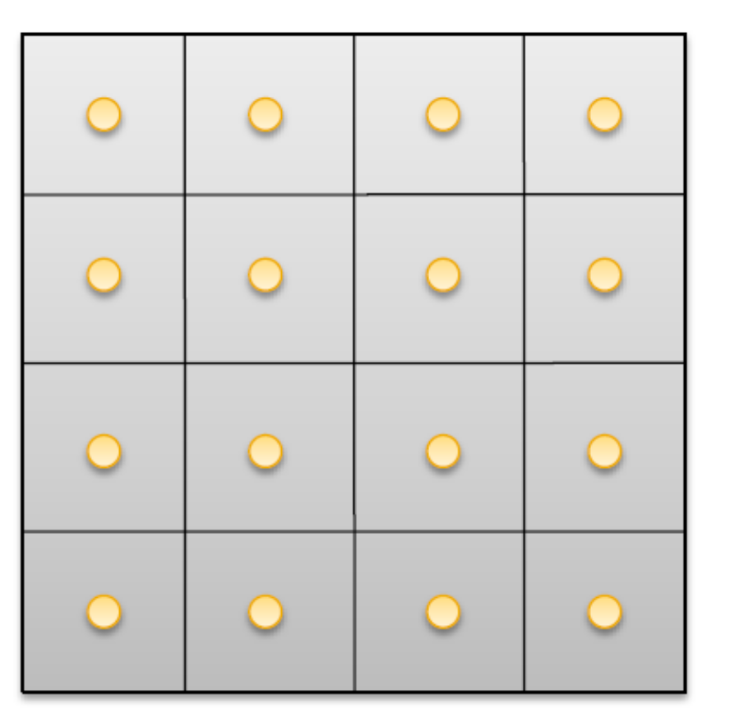
Texture Abstract Structure
A 1D, 2D, or 3D array.
Example 4x4:
Values
Set by the Program

Slide 6
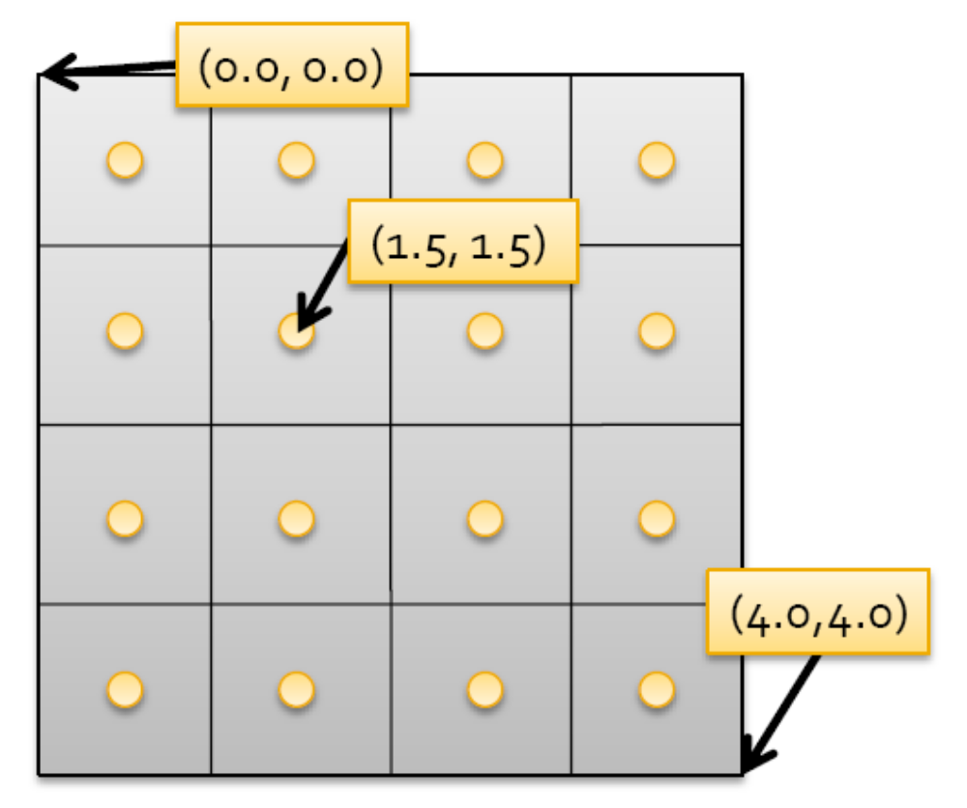
Regular Indexing
Indexes are floating point numbers
  Think of the texture as a surface as opposed to a grid for which you have a grid of samples
Not there

Slide 7
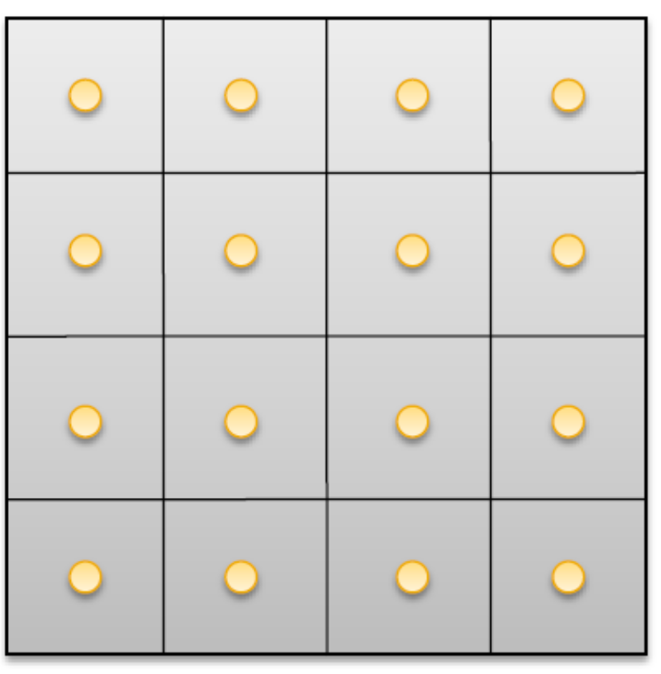
Normalized Indexing
NxM Texture:
  [0,1.0) x [0.0, 1.0) indexes
(0.0,0.0)
(0.5,0.5)
(1.0,1.0)
Convenient if you want to express the computation in size-independent terms

Slide 8
How to think about program values
Values

Slide 9
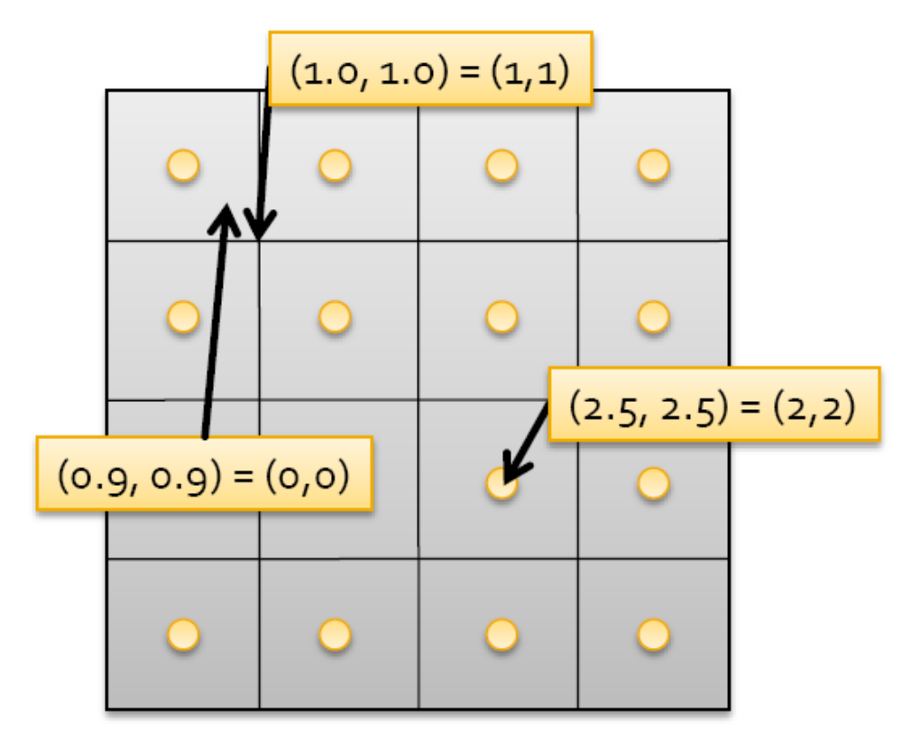
What Value Does a Texture Reference Return?
Nearest-Point Sampling
  Comes for “free”
  Elements must be floats

Slide 10
Nearest-Point Sampling
In this filtering mode, the value returned by the texture fetch is
  tex(x) = T[i] for a one-dimensional texture,
  tex(x, y) = T[i, j] for a two-dimensional texture,
  tex(x, y, z) = T[i, j, k] for a three-dimensional texture,
where i = floor(x) , j = floor( y) , and k = floor(z) .

Slide 11
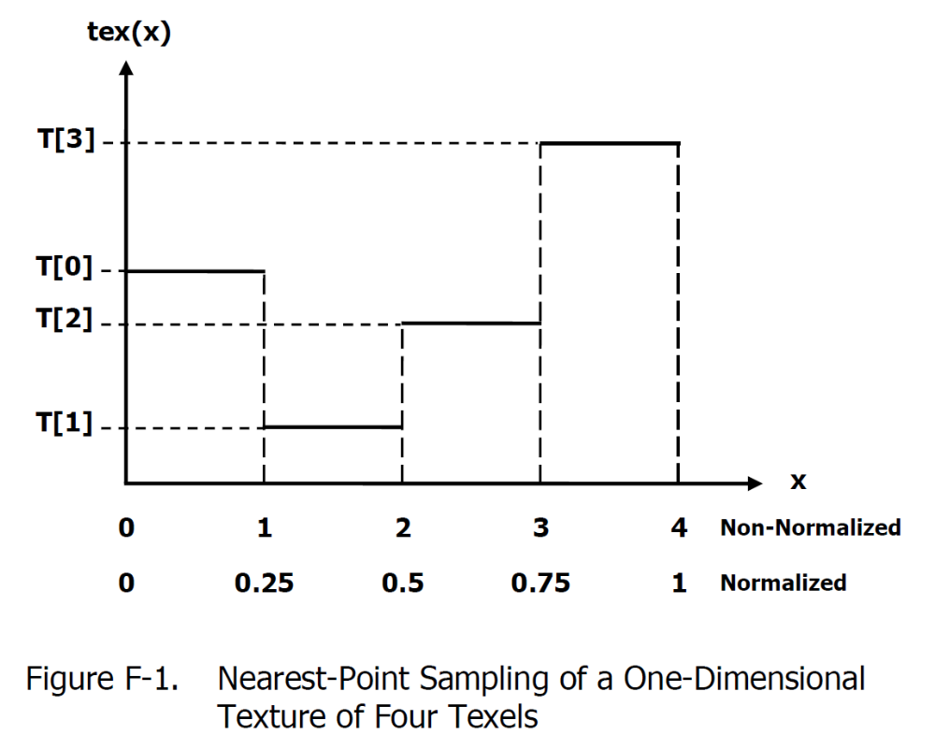
Nearest-Point Sampling: 4-Element 1D Texture
Behaves more like a conventional array

Slide 12
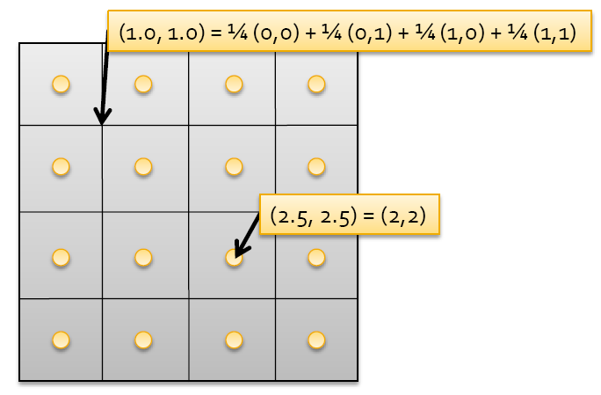
Another Filtering Option
Linear Filtering
See Appendix D of the Programming Guide

Slide 13
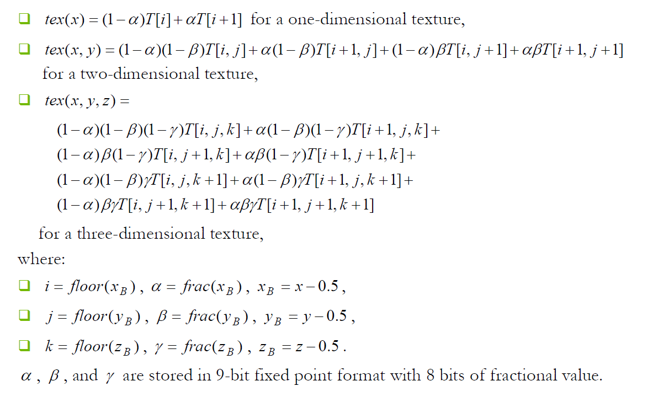
Linear-Filtering Detail
Good luck with this one:
Effectively the value read is a weighted average of all neighboring texels

Slide 14
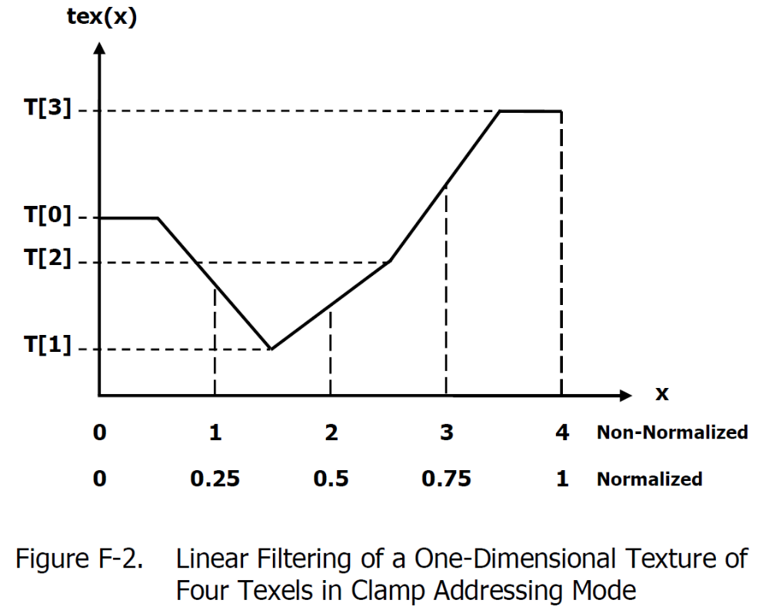
Linear-Filtering: 4-Element 1D Texture

Slide 15
Dealing with Out-of-Bounds References
Clamping
  Get’s stuck at the edge
    i < 0 → actual i = 0
    i > N -1 → actual i = N -1
Warping
  Warps around
    actual i = i MOD N
    Useful when texture is a periodic signal

Slide 16
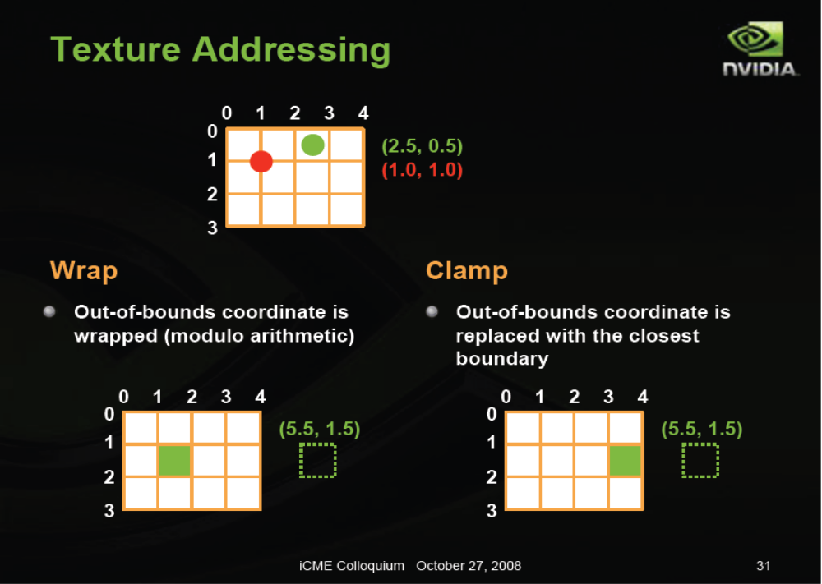
Texture Addressing Explained

Slide 17
Texels
Texture Elements
  All elemental datatypes
    Integer, char, short, float (unsigned)
  CUDA vectors: 1, 2, or 4 elements
    char1, uchar1, char2, uchar2,
    char4, uchar4, short1, ushort1, short2, ushort2,
    short4, ushort4, int1, uint1,
    int2, uint2, int4, uint4, long1,
    ulong1, long2, ulong2, long4,
    ulong4, float1, float2, float4,

Slide 18
Programmer’s view of Textures
Texture Reference Object
  Use that to access the elements
  Tells CUDA what the texture looks like
Space to hold the values
  Linear Memory (portion of memory)
    Only for 1D textures
  CUDA Array
    Special CUDA Structure used for Textures
      Opaque
Then you bind the two:
  Space and Reference

Slide 19
Texture Reference Object
  texture<Type, Dim, ReadMode> texRef;
Type = texel datatype
Dim = 1, 2, 3
ReadMode:
  What values are returned
    cudaReadModeElementType
      Just the elements → What you write is what you get
    cudaReadModeNormalizedFloat
      Works for chars and shorts (unsigned)
      Value normalized to [0.0, 1.0]

Slide 20
CUDA Containers: Linear Memory
Bound to linear memory
  Global memory is bound to a texture
    CudaMalloc()
  Only 1D
  Integer addressing
  No filtering, no addressing modes
  Return either element type or normalized float

Slide 21
CUDA Containers: CUDA Arrays
Bound to CUDA arrays
  CUDA array is bound to a texture
  1D, 2D, or 3D
  Float addressing
    size-based, normalized
  Filtering
  Addressing modes
    clamping, warping
  Return either element type or normalized float

Slide 22
CUDA Texturing Steps
Host (CPU) code:
  Allocate/obtain memory
    global linear, or CUDA array
  Create a texture reference object
    Currently must be at file-scope
  Bind the texture reference to memory/array
  When done:
    Unbind the texture reference, free resources
Device (kernel) code:
  Fetch using texture reference
  Linear memory textures:
    tex1Dfetch()
  Array textures:
    tex1D(), tex2D(), tex3D()

Slide 23
Texture Reference Parameters
Immutable parameters @ compile-time
Specified at compile time
  Type: texel type
    Basic int, float types
    CUDA 1-, 2-, 4-element vectors
  Dimensionality:
    1, 2, or 3
  Read Mode:
    cudaReadModeElementType
    cudaReadModeNormalizedFloat
      valid for 8- or 16-bit ints
      returns [-1,1] for signed, [0,1] for unsigned

Slide 24
Texture Reference Mutable Parameters
Mutable parameters
Can be changed at run-time
  only for array-textures
  Normalized:
    non-zero = addressing range [0, 1]
  Filter Mode:
    cudaFilterModePoint
    cudaFilterModeLinear
  Address Mode:
    cudaAddressModeClamp
    cudaAddressModeWrap

Slide 25
Example: Linear Memory
// declare texture reference (must be at file-scope)
Texture<unsigned short, 1, cudaReadModeNormalizedFloat> texRef;
// Type, Dimensions, return value normalization
// set up linear memory on Device
unsigned short *dA = 0;
cudaMalloc ((void**)&dA, numBytes);
// Copy data from host to device
cudaMempcy(dA, hA, numBytes, cudaMemcpyHostToDevice);
// bind texture reference to array
cudaBindTexture(NULL, texRef, dA, numBytes);

Slide 26
How to Access Texels In Linear Memory Bound Textures
Type tex1Dfetch(texRef, int x);
Where Type is the texel datatype
Previous example:
  Unsigned short
  value = tex1Dfetch (texRef, 10)
  Returns element 10
You can write to the memory holding the texture → dA allocated with cudaMalloc
  Bad idea → no hardware guarantees

Slide 27
CUDA Array Type
Got to specify two things:
  Channel format
  Dimensions
CudaMallocArray
  2D arrays
CudaMallocArray3D
  3D arrays
Management functions:
  cudaMallocArray, cudaFreeArray,
  cudaMemcpyToArray, cudaMemcpyFromArray, ...

Slide 28
Channel Descriptors
What data appears on each element
  Think of images for example
  Every element is an RBG value
cudaChannelFormatDesc structure
  int x, y, z, w:
    parts for each component
    Number of bits: e.g., 8
  enum cudaChannelFormatKind – one of:
    cudaChannelFormatKindSigned
    cudaChannelFormatKindUnsigned
    cudaChannelFormatKindFloat
  Some predefined constructors:
    cudaCreateChannelDesc<float>(void);
    cudaCreateChannelDesc<float4>(void);
Management functions:
  cudaMallocArray, cudaFreeArray,
  cudaMemcpyToArray, cudaMemcpyFromArray, ...

Slide 29
Example Host Code for 2D array
// declare texture reference (must be at file-scope)
Texture<float, 2, cudaReadModeElementType> texRef;
// set up the CUDA array
cudaChannelFormatDesc cf = cudaCreateChannelDesc<float>();
cudaArray *texArray = 0;
cudaMallocArray(&texArray, &cf, dimX, dimY);
cudaMempcyToArray(texArray, 0,0, hA, numBytes, cudaMemcpyHostToDevice);
// specify mutable texture reference parameters
texRef.normalized = 0;
texRef.filterMode = cudaFilterModeLinear;
texRef.addressMode = cudaAddressModeClamp;
// bind texture reference to array
cudaBindTextureToArray(texRef, texArray);

Slide 30
Accessing Texels
Type tex1D(texRef, float x);
Type tex2D(texRef, float x, float y);
Type tex3D(texRef, float x, float y, float z);

Slide 31
At the end
cudaUnbindTexture (texRef)

Slide 32
Dimension Limits
In Elements not bytes
  In CUDA Arrays:
    1D: 8K
    2D: 64K x 32K
    3D: 2K x 2K x 2K
  If in linear memory: 2^27
    That’s 128M elements
    Floats:
      128M x 4 = 512MB
    Not verified:
    Info from: Cyril Zeller of NVIDIA
      http://forums.nvidia.com/index.php?showtopic=29545&view=findpost&p=169592

Slide 33
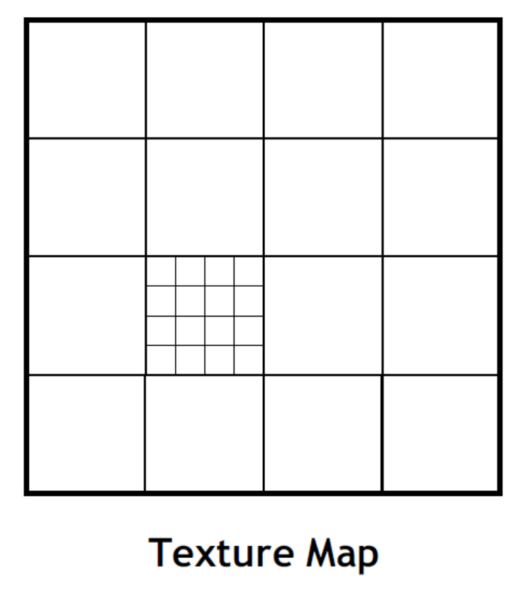
Textures are Optimized for 2D Locality
Regular Array Allocation
  Row-Major
Because of Filtering
  Neighboring texels
  Accessed close in time

Slide 34
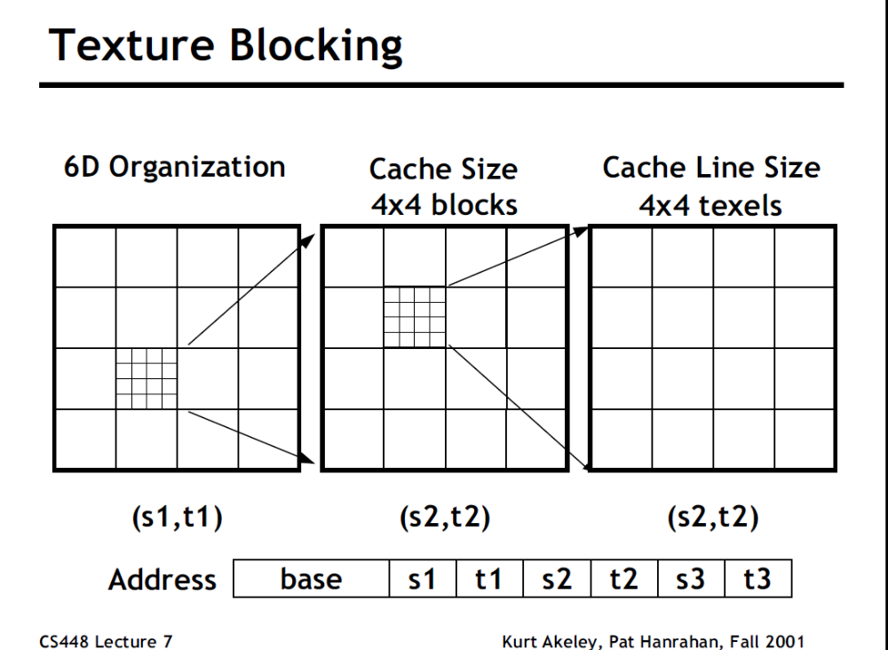
Textures are Optimized for 2D Locality

Slide 35
Using Textures
Textures are read-only
  Within a kernel
A kernel can produce an array
  Cannot write CUDA Arrays
Then this can be bound to a texture for the next kernel
Linear Memory can be copied to CUDA Arrays
  cudaMemcpyFromArray()
    Copies linear memory array to a CudaArray
  cudaMemcpyToArray()
    Copies CudaArray to linear memory array

Slide 36
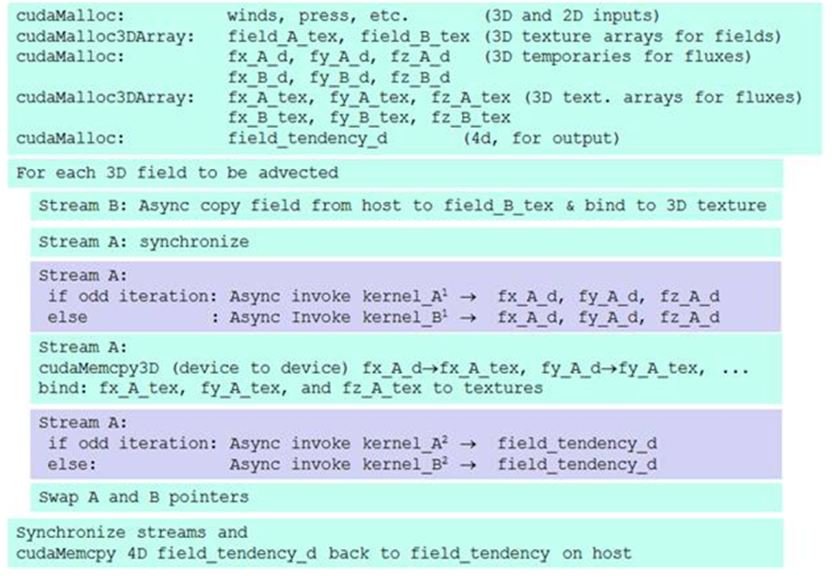
An Example
http://www.mmm.ucar.edu/wrf/WG2/GPU/Scalar_Advect.htm
GPU Acceleration of Scalar Advection

Slide 37
Cuda Arrays
Read the CUDA Reference Manual
Relevant functions are the ones with “Array” in it
Remember:
  Array format is opaque
Pitch:
  Padding added to achieve good locality
  Some functions require this pitch to be passed as a an argument
  Prefer those that use it from the Array structure directly

